Slide 1
Line Follower
Python with Robots Mission 6
Lesson 2 Objectives 4-6

Slide 2

Pre-Mission Warm-Up
In your Mission 6 Lesson 2 log, answer the pre-mission warm-up questions:
Complete the tables for
The list
The LEDs

Slide 3

Mission 6: Line Follower
In this project you will build and refine a line following robot.
Line followers are a staple in robotics competitions, such as races or mazes.
But even basic line followers aren’t just for competitions!
Robots that zip through warehouses often follow lines as they pick up items you order when shopping online.

Slide 4
Mission 6: Line Follower
Project Goals:
Create a basic line follower using 2-edge sensors.
Improve the design with a center-line sensor to keep it straight.
Use all 5 sensors for proportional steering control.

Slide 5
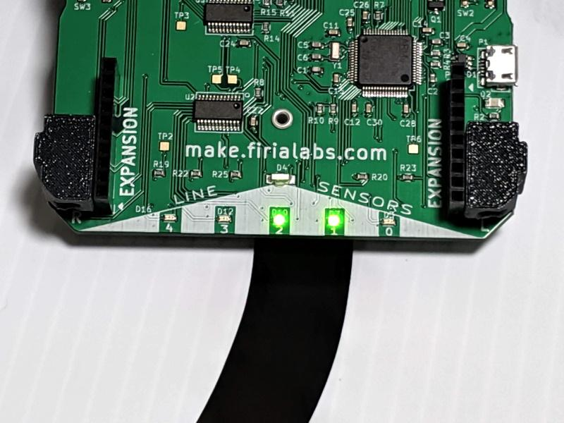
Mission 6: Line Follower
For this lesson, we will work on the first two tasks:
Create a basic line follower using 2-edge sensors.
Improve the design with a center-line sensor to keep it straight.

Slide 6
Data Type Review
You are going to learn a new data type in this lesson. So first, lets review the data types you already know.
String
Integer
Float (a decimal number)
List
In your mission log, identify the data types of the values.

Slide 7
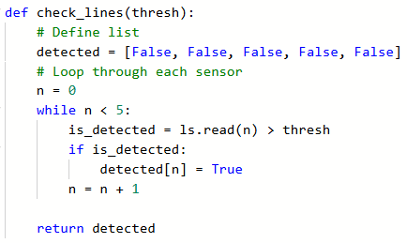
Objective #4: Down to the Metal!
In Objective #3, you completed a program that could read all five line sensors.
Open your program and review the code.
You defined a function that used a loop to read all five sensors.

Slide 8
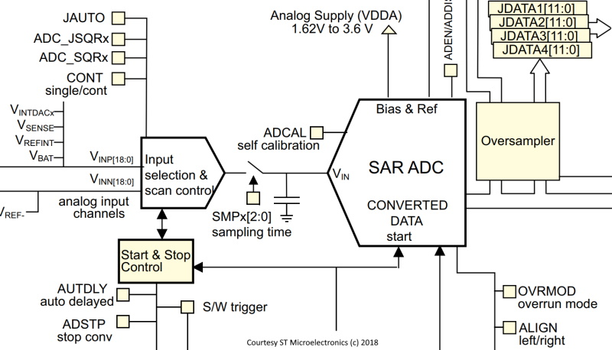
Objective #4: Down to the Metal!
But could there be an even FASTER way?
The CodeBot’s hardware can be configured to scan multiple inputs fast!
Way faster than your check_lines() code can possibly run.

Slide 9
Objective #4: Down to the Metal!
Taking check_lines() to the hardware level.
Writing code that controls hardware directly is called programming down to the metal.
The botcore library provides some pre-coded functions for the line sensors that take advantage of CodeBot’s capabilities.

Slide 10
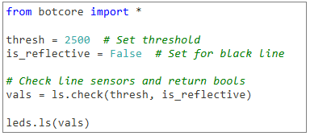
Objective #4: Down to the Metal!
Concept: ls_check()
This is one of the pre-coded functions available in botcore.
It is similar to check_lines(), but faster.
To use it, first define a threshold value and the reflectivity

Slide 11
Objective #4: Down to the Metal!
Concept: ls_check()
The function ls_check() can easily replace check_lines().
The is_reflective parameter controls the condition
Use either < thresh or > thresh

Slide 12
Objective #4: Down to the Metal!
Concept: tuple
The function ls_check() returns a tuple instead of a list.
A tuple is like a list, but read-only.
A tuple is immutable (which means it cannot be changed).
A tuple is defined with parenthesis ().
The same coding for a list works for a tuple.
my_tuple = (5, 4, 3, 2, 1) / vals = (False, True, True, False, False)

Slide 13
Objective #4: Down to the Metal!
Concept: tuple
Examples
my_tuple = (5, 4, 3, 2, 1, 0)
len(my_tuple) | 6
my_tuple[0] | 5
my_tuple[2] | 3
my_tuple[5] | 0
vals = (False, True, True, False, False)
len(vals) | 5
vals[0] | False
vals[1] | True
vals[4] | False

Slide 14
Objective #4: Down to the Metal!
Concept: tuple
You can’t make any changes to a tuple like you can a list, like change a value or add an item.
But for this program, you don’t need to make any changes. A tuple works great.

Slide 15
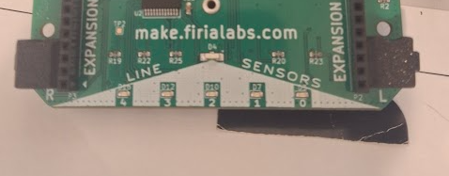
Objective #4 Activity
DO THIS:
Get the Test Surface paper and your ‘bot
Place the ‘bot on the white surface, and put a small black paper under a couple sensors.
Open the Console Panel.

Slide 16

Objective #4 Activity
DO THIS:
Type this code in the Console Panel.
Record the tuple of integers from the sensor in your mission log.

Slide 17
Objective #4 Activity
DO THIS:
Type this code in the Console Panel.
Record the tuple of Bools in your mission log.

Slide 18
Objective #4 Activity
DO THIS:
Start a new file – LineFollow.
Follow CodeTrek to write the code.
Run the code. Surprise!
It appears the same as CheckLines, but now you are rolling with the metal!

Slide 19
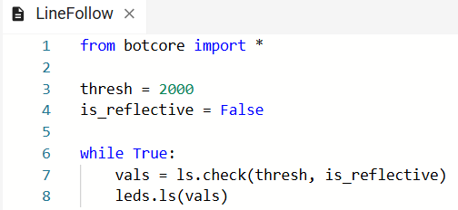
Objective #4 Activity

Slide 20
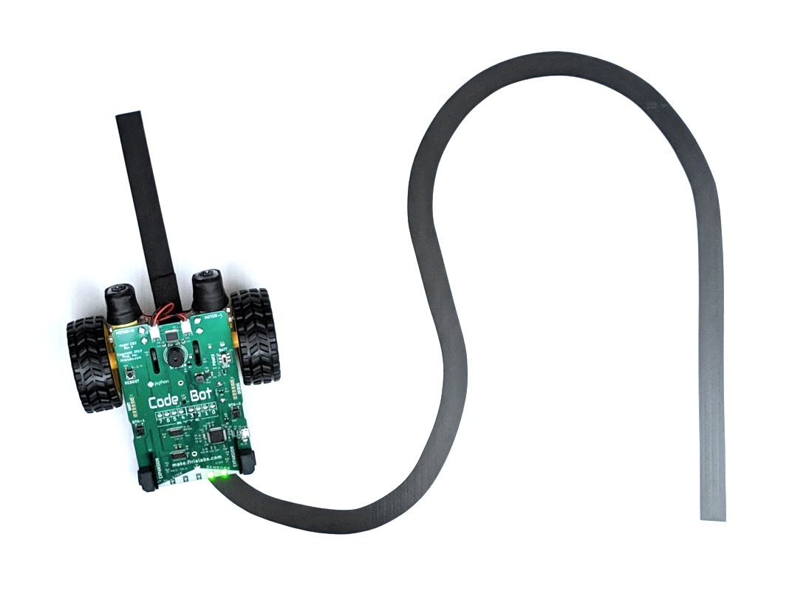
Objective #5: Between the Edges
Your first line following algorithm will be simple:
Start the ‘bot on a black line.
Move forward, reading the line sensors.
If the LEFT sensor (0) hits a line, turn left.
If the RIGHT sensor (4) hits a line, turn right.

Slide 21
Objective #5: Between the Edges
You already have a loop that reads the line sensors.
Add just a few lines of code to control the motors.
Then you will have your first line follower!

Slide 22
Objective #5 Activity
DO THIS:
Add a constant to your code for the SPEED.
Add a loop for safety – remember to wait for the button press!?

Slide 23
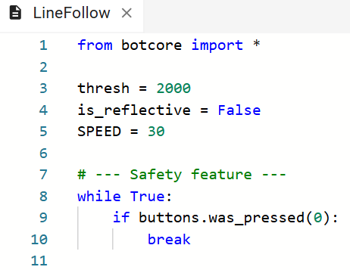
Objective #5 Activity
DO THIS:

Slide 24
Objective #5 Activity
DO THIS:
Enable the motors
Add an if/elif/else block to the code to control movement.
If LEFT sensor (0) detects a line (TRUE) then turn left.
Else if RIGHT sensor (4) detects a line (TRUE) then turn right.
Else move forward.

Slide 25
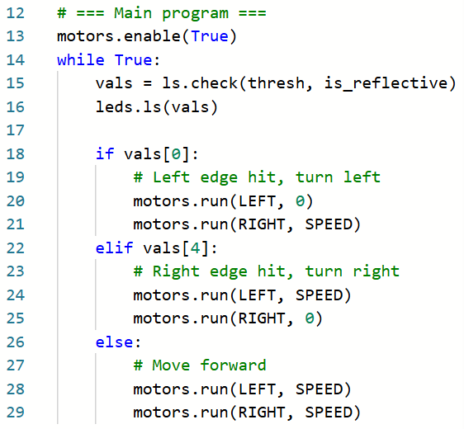

Slide 26
Objective #5 Activity
Try it:
Place the ‘bot on a black line and run the code.

Slide 27
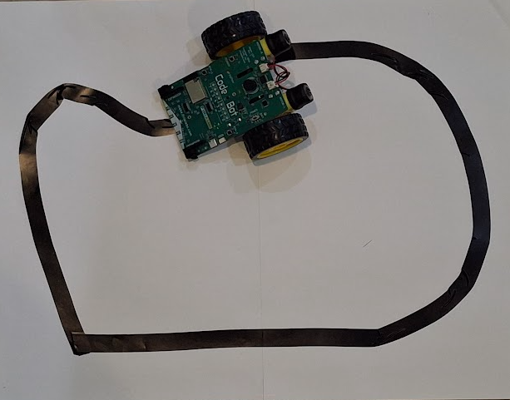
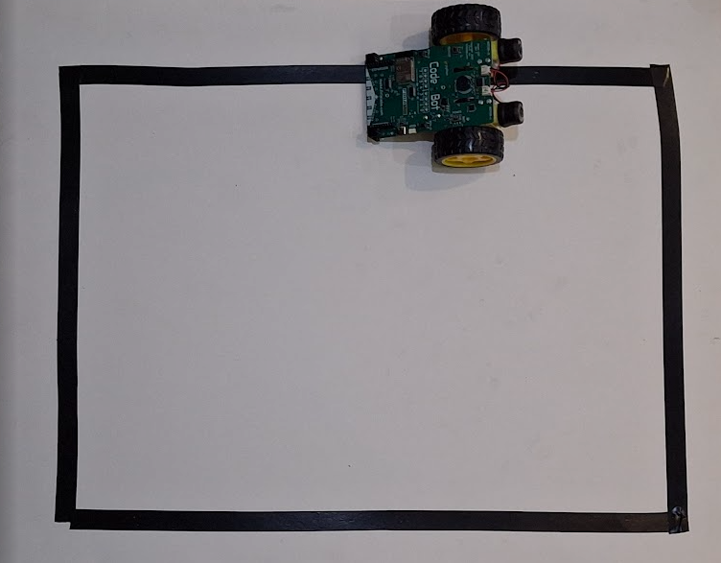
Objective #5 Activity
Adjust the speed – try going faster!
Try different tracks:
Nice curves, sharp angles, gaps
Write your observations in your mission log.

Slide 28

Objective #6: Increased Reliability and Speed
Not too bad!
Your ‘bot can navigate some pretty twisty roads.
Even with just two sensors.
But it has limitations.

Slide 29
Objective #6: Increased Reliability and Speed
You can make your Line Follower faster and better at tracking lines.
Just make some small changes to your code.
When does the ‘bot fail to follow the line?

Slide 30
Objective #6: Increased Reliability and Speed
What if your ‘bot overshoots the line?
Once it is off the line, it is back to “Move Forward.”
So the slightest overshoot when turning can send the ‘bot off the line.
Then it keeps going!

Slide 31
Objective #6: Increased Reliability and Speed
One fix is to keep turning when the line is lost, until it is found again.
Only move forward if you are on a line!
Use the middle three sensors to confirm you are on a line.

Slide 32
Objective #6: Increased Reliability and Speed
Concept: logical operators
Sometimes you need to look at more than one condition.
To allow for multiple conditions, use a logical operator:
Two logical operators are and and or

Slide 33
Objective #6: Increased Reliability and Speed
Concept: logical operators
When using and, all conditions must be true for the comparison to be true.
Condition 1 A | Condition 2 B | Comparison A and B
True | True | True
True | False | False
False | True | False
False | False | False

Slide 34
Objective #6: Increased Reliability and Speed
Concept: logical operators
When using or, only one condition must be true for the comparison to be true.
Condition 1 A | Condition 2 B | Comparison A or B
True | True | True
True | False | True
False | True | True
False | False | False

Slide 35
Objective #6: Increased Reliability and Speed
For this modification, you will use the logical operator or.
If line sensor 1 or line sensor 2 or line sensor 3 detects a line, move forward.

Slide 36
Objective #6 Activity
DO THIS:
Modify your code.
Change the else to an elif.
Use the middle line sensors.

Slide 37
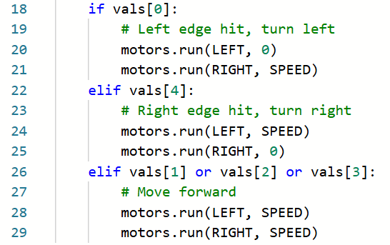
Objective #6 Activity

Slide 38
Objective #6 Activity
Try it:
Place the ‘bot on a black line.
Run the code.
Adjust the speed – try going faster!
Try different tracks:
Nice curves, sharp angles, gaps
Write your observations in your mission log.

Slide 39

Extensions
Here are two additional elements you can add to your program:
Add code for pressing BTN-1 to stop the program (break).
Add a sound when the ‘bot turns left, a sound when the ‘bot turns right, and a different sound (or no speaker) when the ‘bot moves forward.

Slide 40
Post-Mission Reflection
Complete the post-mission reflection in your Mission 6 Lesson 2 Log:
How is ls.check() different from check_lines()?

